Slide 1
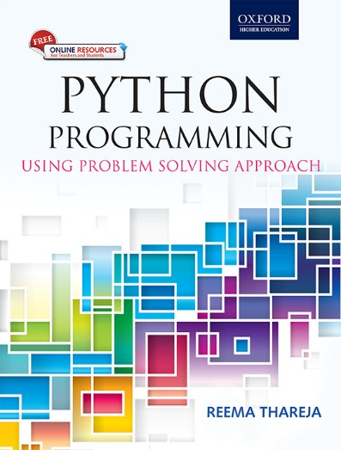
1
Python Programming
Using Problem Solving Approach
Reema Thareja

Slide 2
CHAPTER 8
Data Structures
© Oxford University Press 2017. All rights reserved.

Slide 3
Data Structure: Sequence
A data structure is a group of data elements that are put together under one name. Data structure defines a
particular way of storing and organizing data in a computer so that it can be used efficiently.
Sequence is the most basic data structure in Python. In sequence, each element has a specific index. This index value starts from zero and is automatically incremented for the next element. In Python, sequence is the generic term for an ordered set. For example, we have already studied strings which are a sequence of characters.
Python has some basic built-in functions that help programmers to manipulate elements that form a part
of a sequence. These functions include finding the length of a sequence, finding the largest and smallest
elements in a sequence, etc. Other operations that can be performed on a sequence include indexing, slicing,
adding, multiplying, and checking for membership.
© Oxford University Press 2017. All rights reserved.

Slide 4
Lists
List is a versatile data type available in Python. It is a sequence in which elements are written as a list of
comma-separated values (items) between square brackets. The key feature of a list is that it can have elements that belong to different data types. The syntax of defining a list can be given as,
List_variable = [val1, val2,...]
Examples:
© Oxford University Press 2017. All rights reserved.

Slide 5
Access Values in Lists
Similar to strings, lists can also be sliced and concatenated. To access values in lists, square brackets are used to slice along with the index or indices to get value stored at that index. The syntax for the slice operation is given as, seq = List[start:stop:step]
Example:
© Oxford University Press 2017. All rights reserved.

Slide 6
Updating Values in Lists
Once created, one or more elements of a list can be easily updated by giving the slice on the left-hand side of the assignment operator. You can also append new values in the list and remove existing value(s) from the list using the append() method and del statement respectively.
Example:
© Oxford University Press 2017. All rights reserved.

Slide 7
Nested Lists
Nested list means a list within another list. We have already said that a list has elements of different data types which can include even a list.
Example:
© Oxford University Press 2017. All rights reserved.

Slide 8
Cloning Lists
If you want to modify a list and also keep a copy of the original list, then you should create a separate copy of the list (not just the reference). This process is called cloning. The slice operation is used to clone a list.
Example:
© Oxford University Press 2017. All rights reserved.

Slide 9
Basic List Operations
© Oxford University Press 2017. All rights reserved.

Slide 10
List Methods
© Oxford University Press 2017. All rights reserved.

Slide 11
Using Lists as Stack
Stack is an important data structure which stores its elements in an ordered manner. Stack is a linear data structure which uses the same principle, i.e., the elements in a stack are added and removed only from one end. Hence, a stack is called a LIFO (Last-In-First-Out) data structure, as the element that was inserted last is the first one to be taken out.
© Oxford University Press 2017. All rights reserved.

Slide 12
Using Lists as Stack
Example:
© Oxford University Press 2017. All rights reserved.

Slide 13
Using Lists as Queues
Queue is an important data structure which stores its elements in an ordered manner. In computer systems, the operating system makes full use of queues for the following tasks.
• To maintain waiting lists for a single shared resource like printer, disk, CPU, etc.
• To transfer data asynchronously (data not necessarily received at same rate as sent) between two processes (IO buffers), e.g., pipes, file IO, and sockets.
• As buffers on MP3 players and portable CD players, iPod playlist, etc.
• Handling interrupts.
• Queues are also used in the playlist of jukebox to add songs to the end and play from the front of the list.
Queue supports three basic operations—insert, delete, and peep (or peek). In Python, you can easily implement a queue by using the append() method to insert an element at the end of the queue, pop() method with an index 0 to delete the first element from the queue, and slice operation to print the value of the last the element in the queue.
© Oxford University Press 2017. All rights reserved.

Slide 14
Using Lists as Queues
Example:
© Oxford University Press 2017. All rights reserved.

Slide 15
List Comprehensions
Python also supports computed lists called list comprehensions having the following syntax.
List = [expression for variable in sequence]
Where, the expression is evaluated once, for every item in the sequence.
List comprehensions help programmers to create lists in a concise way. This is mainly beneficial to make new lists where each element is the obtained by applying some operations to each member of another sequence or iterable. List comprehension is also used to create a subsequence of those elements that satisfy a certain condition.
Example:
© Oxford University Press 2017. All rights reserved.

Slide 16
Looping in Lists
Python's for and in constructs are extremely useful especially when working with lists. The for var in list statement is an easy way to access each element in a list (or any other sequence). For example, in the
following code, the for loop is used to access each item in the list.
for i in list:
print(i)
Example:
© Oxford University Press 2017. All rights reserved.

Slide 17
Using the enumerate() and range() Functions
enumerate() function is used when you want to print both index as well as an item in the list. The function returns an enumerate object which contains the index and value of all the items of the list as a tuple.
The range() function is used when you need to print index.
Examples:
© Oxford University Press 2017. All rights reserved.

Slide 18
Using an Iterator
You can create an iterator using the built-in iter() function. The iterator is used to loop over the elements of the list. For this, the iterator fetches the value and then automatically points to the next element in the list when it is used with the next() method.
Example:
© Oxford University Press 2017. All rights reserved.

Slide 19
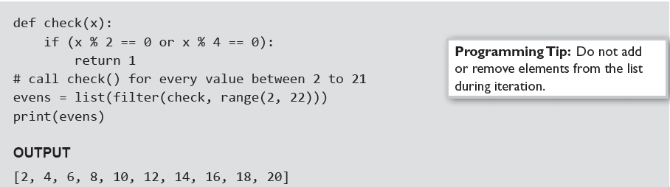
filter() Function
The filter() function constructs a list from those elements of the list for which a function returns True. The
syntax of the filter() function is given as, filter(function, sequence)
As per the syntax, the filter() function returns a sequence that contains items from the sequence for which the function is True. If sequence is a string, Unicode, or a tuple, then the result will be of the same type;
otherwise, it is always a list.
Example:
© Oxford University Press 2017. All rights reserved.

Slide 20

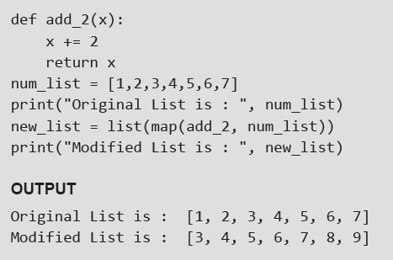
map() Function
The map() function applies a particular function to every element of a list. Its syntax is same as the filter function
After applying the specified function on the sequence, the map() function returns the modified list. The map() function calls function(item) for each item in the sequence and returns a list of the return values.
Example: Program that adds 2 to every value in the list
© Oxford University Press 2017. All rights reserved.

Slide 21

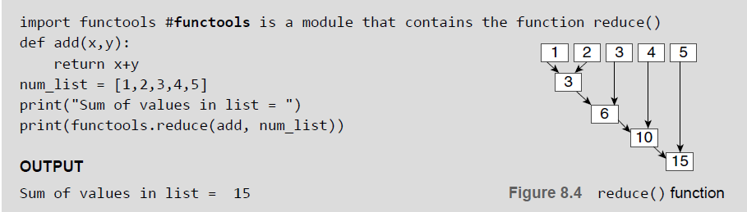
reduce() Function
The reduce() function with syntax as given below returns a single value generated by calling the function
on the first two items of the sequence, then on the result and the next item, and so on.
Example: Program to calculate the sum of values in a list using the reduce() function
© Oxford University Press 2017. All rights reserved.

Slide 22
Tuple
Like lists, tuple is another data structure supported by Python. It is very similar to lists but differs in two things.
• First, a tuple is a sequence of immutable objects. This means that while you can change the value of one or more items in a list, you cannot change the values in a tuple.
• Second, tuples use parentheses to define its elements whereas lists use square brackets.
Creating Tuple
Creating a tuple is very simple and almost similar to creating a list. For creating a tuple, generally you need to just put the different comma-separated values within a parentheses as shown below.
Tup1 = (val 1, val 2,...)
where val (or values) can be an integer, a floating number, a character, or a string.
© Oxford University Press 2017. All rights reserved.

Slide 23
Utility of Tuples
In real-world applications, tuples are extremely useful for representing records or structures as we call
in other programming languages. These structures store related information about a subject together.
The information belongs to different data types.
For example, a tuple that stores information about a student can have elements like roll_no, name, course, total marks, avg, etc. Some built-in functions return a tuple. For example, the divmod() function returns two values—quotient as well as the remainder after performing the divide operation.
Examples:
© Oxford University Press 2017. All rights reserved.

Slide 24
Accessing Values in a Tuple
Like other sequences (strings and lists) covered so far, indices in a tuple also starts at 0. You can even perform
operations like slice, concatenate, etc. on a tuple. For example, to access values in tuple, slice operation is used along with the index or indices to obtain value stored at that index
Example:
© Oxford University Press 2017. All rights reserved.

Slide 25
Deleting Elements in Tuple
Since tuple is an immutable data structure, you cannot delete value(s) from it. Of course, you can create a new tuple that has all elements in your tuple except the ones you don't want (those you wanted to be deleted).
Examples:
© Oxford University Press 2017. All rights reserved.

Slide 26
Basic Tuple Operations
© Oxford University Press 2017. All rights reserved.

Slide 27
Tuple Assignment
Tuple assignment is a very powerful feature in Python. It allows a tuple of variables on the left side of the assignment operator to be assigned values from a tuple given on the right side of the assignment operator.
Each value is assigned to its respective variable. In case, an expression is specified on the right side of the assignment operator, first that expression is evaluated and then assignment is done.
Example:
© Oxford University Press 2017. All rights reserved.

Slide 28
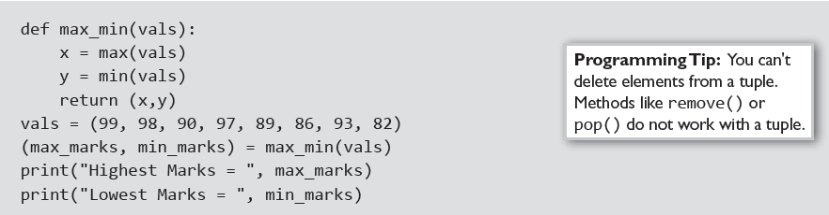
Tuples for Returning Multiple Values and Nested Tuples
Examples:
© Oxford University Press 2017. All rights reserved.

Slide 29
Checking the Index: index() method
The index of an element in the tuple can be obtained by using the index() method. If the element being searched is not present in the list, then error is generated. The syntax of index() is given as, list.index(obj) where, obj is the object to be found out.
Examples:
© Oxford University Press 2017. All rights reserved.

Slide 30
count()Method and List Comprehension and Tuples
Examples:
© Oxford University Press 2017. All rights reserved.

Slide 31
Variable-length Argument Tuples
Many built-in functions like max(), min(), sum(), etc. use variable-length arguments since these functions themselves do not know how many arguments will be passed to them. It allows a function to accept a variable (different) number of arguments. This is especially useful in defining functions that are applicable to a large variety of arguments. For example, if you have a function that displays all the parameters passed to it, then even the function does not know how many values it will be passed. In such cases, we use a variable-length argument that begins with a '*' symbol. Any argument that starts with a '*' symbol is known as gather and specifies a variable-length argument.
Example:
© Oxford University Press 2017. All rights reserved.

Slide 32
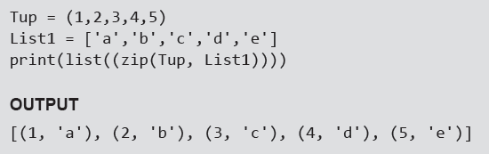
The zip() Function
The zip() is a built-in function that takes two or more sequences and "zips" them into a list of tuples. The tuple thus, formed has one element from each sequence.
Example: Program to show the use of zip() function
© Oxford University Press 2017. All rights reserved.

Slide 33
Advantages of Tuple over List
• Tuples are used to store values of different data types. Lists can however, store data of similar data types.
• Since tuples are immutable, iterating through tuples is faster than iterating over a list. This means that a
tuple performs better than a list.
• Tuples can be used as key for a dictionary but lists cannot be used as keys.
• Tuples are best suited for storing data that is write-protected.
• Tuples can be used in place of lists where the number of values is known and small.
• If you are passing a tuple as an argument to a function, then the potential for unexpected behavior due to
aliasing gets reduced.
• Multiple values from a function can be returned using a tuple.
• Tuples are used to format strings.
© Oxford University Press 2017. All rights reserved.

Slide 34


Sets
Sets is another data structure supported by Python. Basically, sets are same as lists but with a difference that sets are lists with no duplicate entries. Technically, a set is a mutable and an unordered collection of items. This means that we can easily add or remove items from it.
A set is created by placing all the elements inside curly brackets {}, separated by comma or by using the
built-in function set(). The syntax of creating a set can be given as,
Example: To create a set, you can write,
© Oxford University Press 2017. All rights reserved.

Slide 35
Set Operations
© Oxford University Press 2017. All rights reserved.

Slide 36
Set Operations
© Oxford University Press 2017. All rights reserved.

Slide 37
Set Operations
© Oxford University Press 2017. All rights reserved.

Slide 38
Set Operations
© Oxford University Press 2017. All rights reserved.

Slide 39
Dictionaries
Dictionary is a data structure in which we store values as a pair of key and value. Each key is separated from its value by a colon (:), and consecutive items are separated by commas. The entire items in a dictionary are enclosed in curly brackets({}). The syntax for defining a dictionary is
dictionary_name = {key_1: value_1, key_2: value_2, key_3: value_3}
If there are many keys and values in dictionaries, then we can also write just one key-value pair on a line
to make the code easier to read and understand. This is shown below.
dictionary_name = {key_1: value_1, key_2: value_2, key_3: value_3, ….}
Example:
© Oxford University Press 2017. All rights reserved.

Slide 40
Accessing Values
Example:
© Oxford University Press 2017. All rights reserved.

Slide 41
Adding and Modifying an Item in a Dictionary
Example:
© Oxford University Press 2017. All rights reserved.

Slide 42
Modifying an Entry
Example:
© Oxford University Press 2017. All rights reserved.

Slide 43
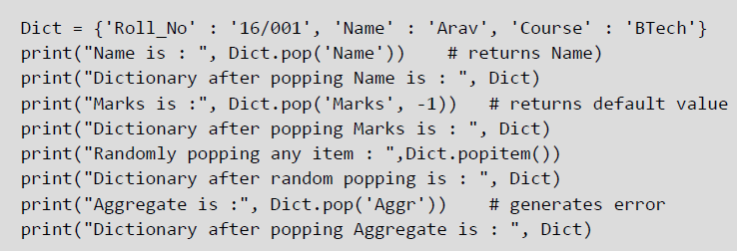
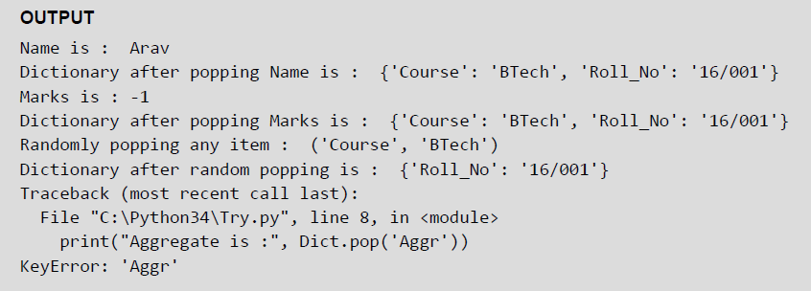
Deleting Items
You can delete one or more items using the del keyword. To delete or remove all the items in just one statement, use the clear() function. Finally, to remove an entire dictionary from the memory, we can gain
use the del statement as del Dict_name. The syntax to use the del statement can be given as,
del dictionary_variable[key]
Example:
© Oxford University Press 2017. All rights reserved.

Slide 44
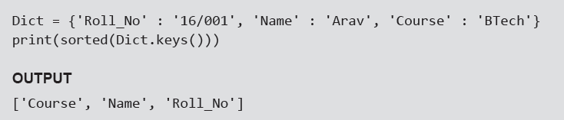
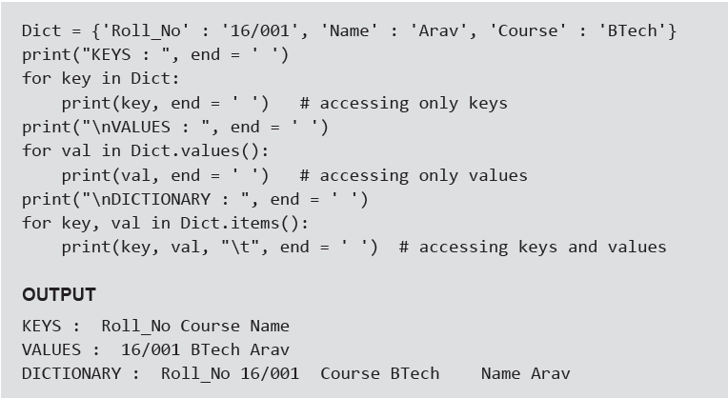
Sorting Items and Looping over Items in a Dictinonary
Examples:
© Oxford University Press 2017. All rights reserved.

Slide 45
Nested Dictionaries
Example:
© Oxford University Press 2017. All rights reserved.

Slide 46
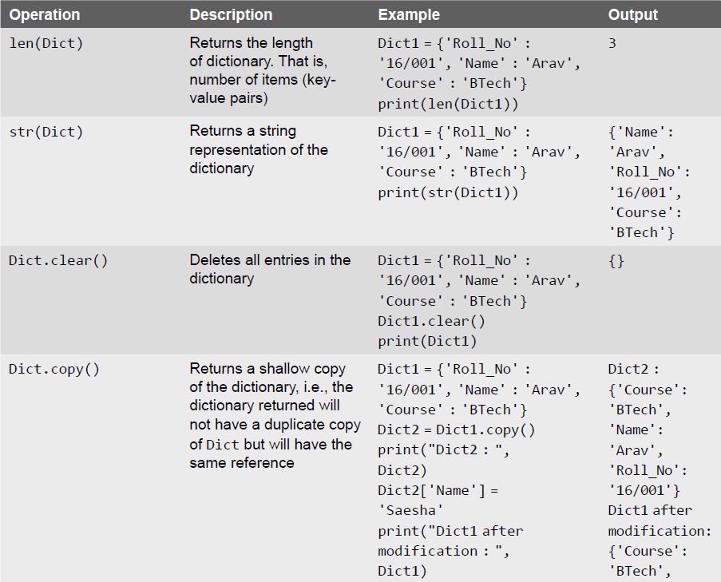
Built-in Dictionary Functions and Methods
© Oxford University Press 2017. All rights reserved.

Slide 47
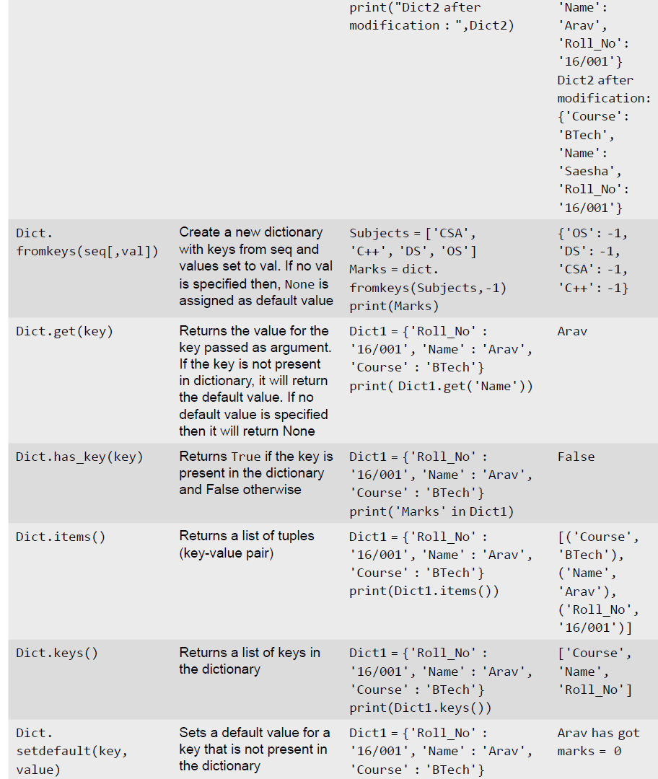
Built-in Dictionary Functions and Methods
© Oxford University Press 2017. All rights reserved.

Slide 48
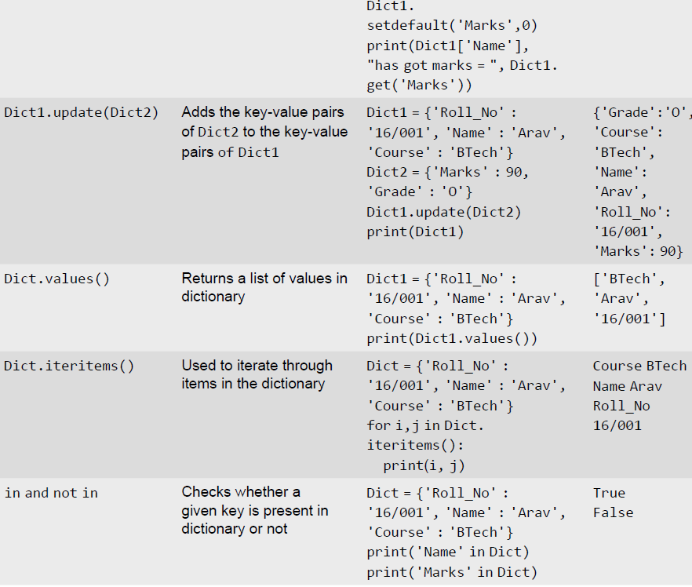
Built-in Dictionary Functions and Methods
© Oxford University Press 2017. All rights reserved.

Slide 49
Difference between a List and a Dictionary
First, a list is an ordered set of items. But, a dictionary is a data structure that is used for matching one item
(key) with another (value).
• Second, in lists, you can use indexing to access a particular item. But, these indexes should be a number. In
dictionaries, you can use any type (immutable) of value as an index. For example, when we write Dict['Name'], Name acts as an index but it is not a number but a string.
• Third, lists are used to look up a value whereas a dictionary is used to take one value and look up another
value. For this reason, dictionary is also known as a lookup table.
Fourth, the key-value pair may not be displayed in the order in which it was specified while defining the
dictionary. This is because Python uses complex algorithms (called hashing) to provide fast access to the items stored in the dictionary. This also makes dictionary preferable to use over a list of tuples.
© Oxford University Press 2017. All rights reserved.

Slide 50
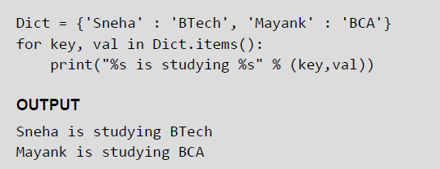
String Formatting with Dictionaries
Python also allows you to use string formatting feature with dictionaries. So you can use %s, %d, %f, etc. to
represent string, integer, floating point number, or any other data.
Example: Program that uses string formatting feature to print the key-value pairs stored in the dictionary
© Oxford University Press 2017. All rights reserved.

Slide 51
When to use which Data Structure?
• Use lists to store a collection of data that does not need random access.
• Use lists if the data has to be modified frequently.
• Use a set if you want to ensure that every element in the data structure must be unique.
• Use tuples when you want that your data should not be altered.
© Oxford University Press 2017. All rights reserved.

